Slide 1
Pathogenic bacteria.
Dr.Munira Ch. Ismail Lec.1

Slide 2
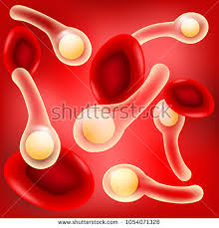
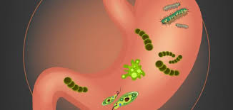
Introduction :
Although the vast majority of bacteria are harmless or beneficial, quite a few bacteria are pathogenic. Pathogenic bacteria are bacteria that cause bacterial infection. One of the bacterial diseases with highest disease burden is tuberculosis, caused by the bacterium Mycobacterium tuberculosis, which kills about 2 million people a year, mostly in sub-Saharan Africa. Pathogenic bacteria contribute to other globally important diseases, such as pneumonia, which can be caused by bacteria such as Streptococcus and Pseudomonas, and food borne illnesses, which can be caused by bacteria such as Shigella, Campylobacter, and Salmonella. Pathogenic bacteria also cause infections such as tetanus, typhoid fever, diphtheria, syphilis, and leprosy.

Slide 3
. Different infection stages of disease causing organisms

Slide 4
Bacteria: - These one-cell organisms are responsible for illnesses such as strep throat, urinary tract infections and tuberculosis.
Factors that Influence the degree of Pathogenicity and the Progression of Infection and Disease .
1-Host factors: Age, sex, ethnicity, nutrition (diet), hormonal status; personal hygiene and immune status; Underlying disease or medical condition; Antibiotic or drug usage; Presence of foreign object (e.g., splinter, catheter, sutures, etc.); Innate differences between hosts .
2-Microbial factors: Bacterial virulence factors; Inoculum size (dosage)
3-External factors (e.g., crowding; seasonal variations; hygiene, sanitation and public health; food processing, storage and preparation; etc.

Slide 5
To cause disease a pathogen must:
✓ Gain access to the host.
✓ Adhere to host tissues.
✓ Penetrate or evade host defenses.
✓ Damage the host, either directly or accumulation of microbial wastes.
Progression of Infection and Disease :
Entrance (Portal of entry).
Colonization (Adherence; Adhesion; Attachment) .

Slide 6
Prevention of Host Defenses:-
Some pathogenic bacteria are inherently able to resist the bactericidal components of host tissues. For example, the poly-D-glutamate capsule of Bacillus anthracis protects the organisms against cell lysis by cationic proteins in sera or in phagocytes. The outer membrane of Gram-negative bacteria is a formidable permeability barrier that is not easily penetrated by hydrophobic compounds such as bile salts which are harmful to the bacteria.
Pathogenic mycobacteria have a waxy cell wall that resists attack or digestion by most tissue bactericides. And intact lipopolysaccharides (LPS) of Gram-negative pathogens may protect the cells from complement-mediated lysis or the action of lysozyme.

Slide 7


